Slide 1
NovaCell Plan Recommender
One banner tells everyone to upgrade. Most customers need a different fit.
Ashokkumar Burasiya · AI Product Manager
9 November 2026 · all data synthetic

Slide 2
Customers are on the wrong plans, in both directions
31%
39%
2.9%
62%
of customers would be at least $3 a month better off on another plan or add-on
of Unlimited customers in the sample use under 10 GB a month
of this year's plan changes were to Unlimited, the product the banner pushes
of the agent playbook's top suggestions would raise the bill > $15 with no usage reason
"I pay $60 for Unlimited and use about 6 GB. The app keeps telling me to upgrade." Kavya, postpaid customer (synthetic)
Source: synthetic NovaCell data (8,000 customers, 10 months, 4,756 plan changes), generated for this project.
NovaCell Plan Recommender · all data synthetic

Slide 3
Discovery: customers want a fit they can trust, not an upsell
Kavya, postpaid customer
"Am I on the right plan?"
Kavya (synthetic quote)
Primary persona (synthetic)
• On Unlimited at $60, uses about 6 GB
• Travels twice a year; got a roaming bill shock
• Ignores in-app banners
• Goal: pay for what she uses, no surprises
"Is this suggestion for me or for NovaCell?"
Kavya (synthetic quote)
"Our playbook only has upgrades in it."
611 agent (synthetic quote)
"Show me which suggestions keep customers, not just which sell."
Head of Digital Sales (synthetic quote)
NovaCell Plan Recommender · all data synthetic

Slide 4
Five whys: suggestions were built to sell, not to fit
1
2
3
4
5
Wrong-fit plans
Nobody shows the fit
Built as upsell
Fit never computed
Trust erodes
Overpaying, or paying pay-as-you-go.
One banner for all; upgrade-only playbook.
Owned by marketing; measured on revenue per call.
Usage, holdings and catalogue in separate systems.
Banners ignored; bill shocks; complaints and churn.
Root cause
Nobody shows customers the plan that fits their own usage. Suggestions were designed as an upsell channel, so they are ignored, and the customers who most need a change never hear about it.
NovaCell Plan Recommender · all data synthetic

Slide 5
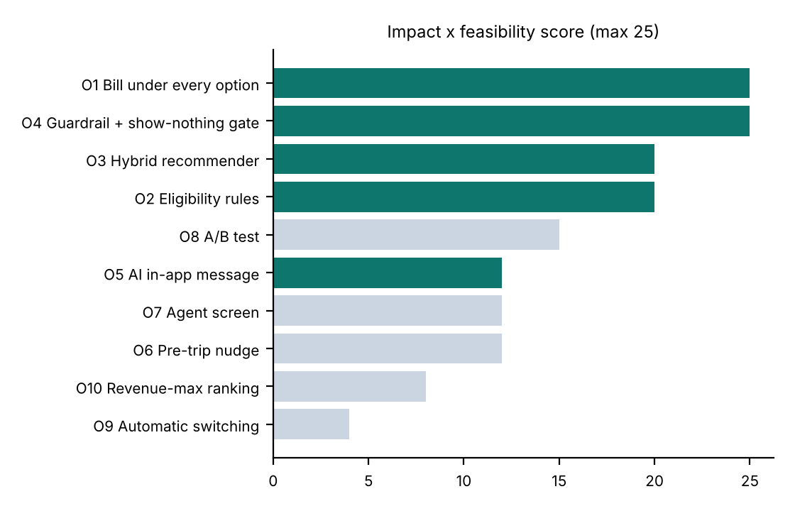
We scored 10 opportunities; five are in the MVP
Built
Bill under every option, eligibility rules, the hybrid recommender, the fit-first guardrail with a show-nothing gate, and the checked AI message.
Next and parked
Next: A/B test, agent screen, pre-trip nudges. Parked: automatic plan switching (consent) and revenue-maximising ranking (recreates the banner).
NovaCell Plan Recommender · all data synthetic

Slide 6
Rules compute the bill, ML learns the fit, the AI only writes
1
2
3
4
Price it
Rank it
Keep it honest
Say it
Rules list eligible options and the bill under each from 3 months of usage.
A gradient-boosted ranker learns what similar customers chose.
Guardrail drops bill shock and plans that would slow 3+ GB of data; gate shows nothing unless $3+ better off.
The LLM writes the message; code checks every number and word.
The customer decides
Nothing changes without a tap. Every suggestion shows its reason and the exact monthly bill change, including when the bill goes up.
NovaCell Plan Recommender · all data synthetic

Slide 7
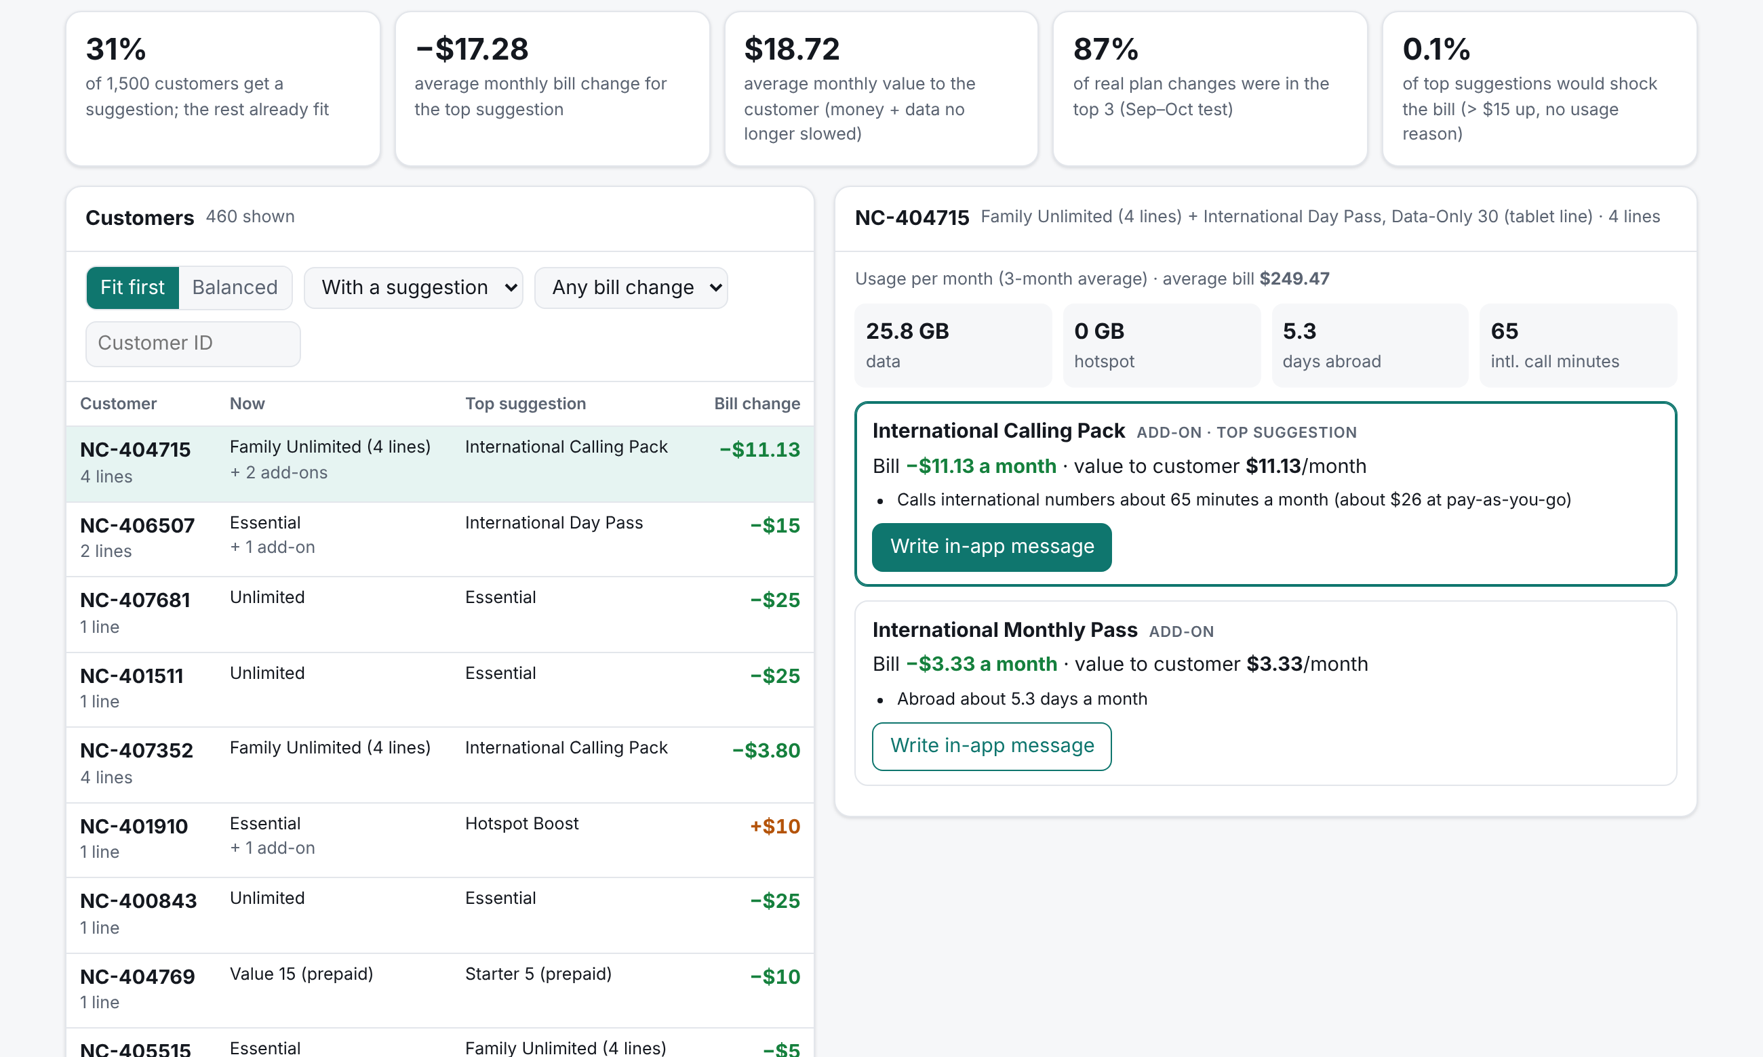
A reason and the bill change for each suggestion, or nothing
What Kavya sees
• Up to 3 suggestions, best first
• The reason, from her own usage
• The monthly bill change, up or down
• Nothing at all if her plan fits (69% of customers)
• A message written by AI and checked by code
NovaCell Plan Recommender · all data synthetic

Slide 8
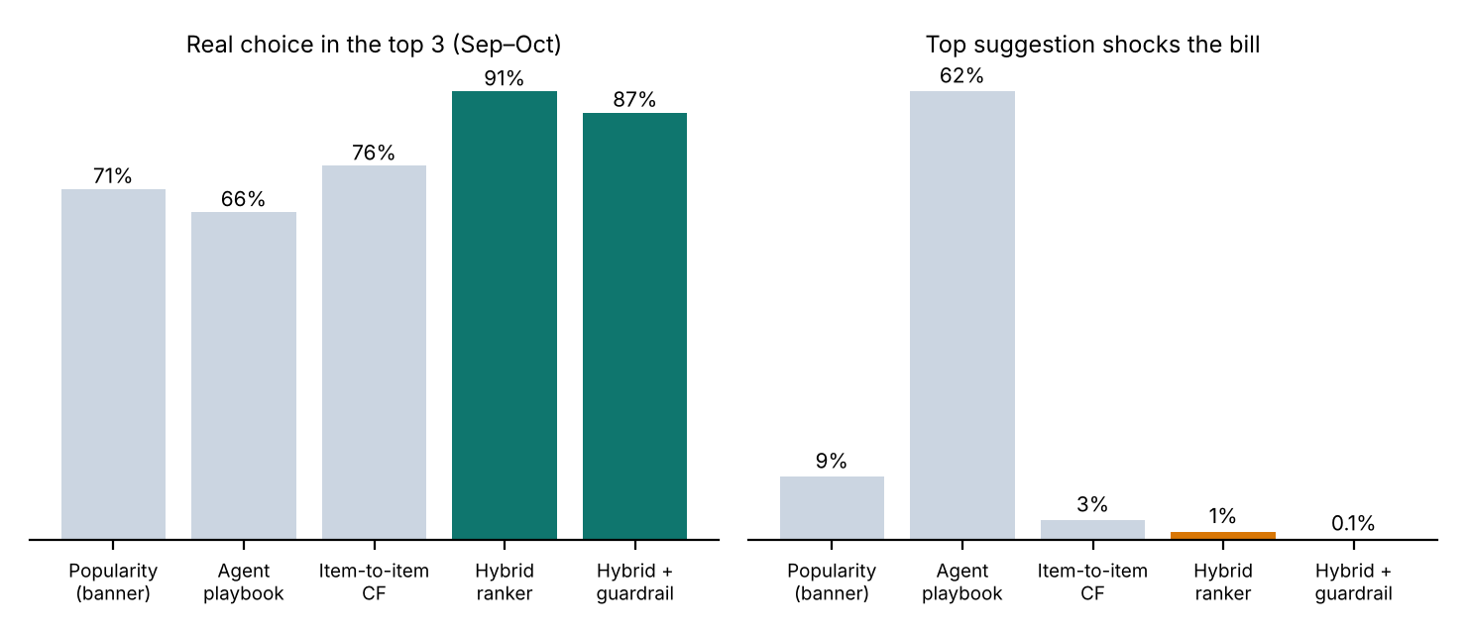
The hybrid ranker wins; the guardrail removes bill shock
87% in the top 3
Trained on April–August choices, tested on September–October.
The playbook: 66% in the top 3, 62% bill shock.
Hybrid ranker: 91%, 1%.
With the guardrail: 87%, 0.1%.
The gate showed suggestions to 37% of customers; 14% changed, vs 8% for a banner to all.
NovaCell Plan Recommender · all data synthetic

Slide 9
The honest trade-off: good fits lower bills
Policy | Shown to | Bill change (top 1) | Value to customer | Break-even churn cut
Fit first | 31% | −$17.28 | +$18.72 | > 100% (needs downgrades that would happen anyway)
Balanced (big downgrades → retention team) | 17% | −$3.98 | +$8.68 | ≈ 26%
Break-even = how much churn among shown customers must fall for revenue kept to cover lower bills (assumptions: 8% adoption, 1.5% monthly churn, $82 average bill).
So we don't pick a policy on opinion. The A/B test runs fit first, balanced and today's banner side by side for 90 days, and measures revenue, churn, bill complaints and how many downgrades would have happened anyway.
NovaCell Plan Recommender · all data synthetic

Slide 10
Guardrails for money, words and fairness
Bill shock or slower data
No rise > $15 unless it removes as much in charges or slowed data; no plan that slows 3+ GB a month; smaller slowdowns stated.
Revenue drop
Balanced policy; A/B test with a 2% revenue guardrail; finance sign-off.
Old banner biased the data
Control group and exploration in the A/B test; monthly retrain.
Message states a wrong price
Every number must be in the facts; template fallback.
Pressure or hidden increase
Pressure and promise words blocked; bill increase must be stated.
Unfair suggestions
Top-3 accuracy by age band, gender, region: p = 0.183, 0.458, 0.616.
NovaCell Plan Recommender · all data synthetic

Slide 11
North Star: revenue retained per 1,000 customers shown
Layer | Metric | Target
AI (ranker) | Top-3 accuracy; bill shock | ≥ 80% (87%); < 1%
AI (message) | Messages passing checks | 100%; AI rate ≥ 90%
Product | Adoption within 30 days | ≥ 2x the banner
Business | 90-day churn; bill complaints | -15%; -25% vs control
Guardrail | Revenue per customer | ≥ control − 2%
Revenue retained per 1,000 shown
12 months, against a control group: revenue kept after lower bills, cancellations and add-ons.
Target: at least control, with lower churn.
It forces the trade-off into one number.
NovaCell Plan Recommender · all data synthetic

Slide 12
Launch evals
Eval | Result | Target
Top-3 accuracy (Sep–Oct) | 87% | ≥ 80%
Bill shock (top 1) | 0.1% | < 1%
Show precision vs banner | 14% vs 8% | above banner
Fairness (age, gender, region) | no significant difference | p ≥ 0.05
Offline message checks | all template messages pass; 5/5 broken caught | 100%
Live AI messages: dev (30) | 100% safe · 96.7% AI-written | 100% safe
Live AI messages: holdout (20) | 100% safe · 100% AI-written | 100% safe
Live AI messages: safety (20) | 100% safe · 90% AI-written | 100% safe
NovaCell Plan Recommender · all data synthetic

Slide 13
Rollout earns trust with a three-arm test
Nov 2026
Jan 2027
Apr 2027
May 2027
Prototype on synthetic data
A/B test: 10% of app users
90-day readout
Roll out the winner
Ranking, bill-shock, fairness and message targets.
Done: live prototype.
Fit first vs balanced vs banner.
Revenue guardrail 2%.
Revenue, churn, complaints, organic downgrades.
Then agent screen and pre-trip nudges.
NovaCell Plan Recommender · all data synthetic

Slide 14
Next: a three-arm A/B test in January
• Approve the test with finance and a 2% revenue guardrail
• Confirm one-tap plan changes in the billing API
• Decide the policy on revenue retained, not on opinion
Try it: novacell-plan-recommender.vercel.app

